Slide 1
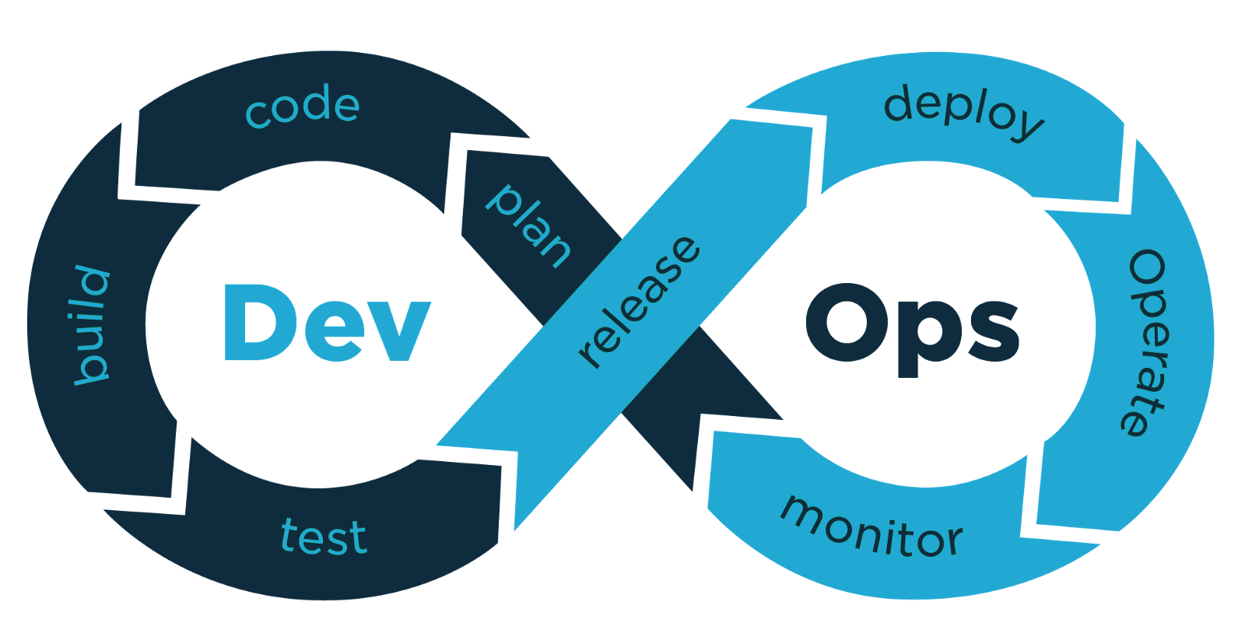
Devops on AWS
20 Feb 2024
Instructor : Sunil Koppavarapu
Email: support@logiclabstech.com

Slide 2
SDLC Model - Software Development Life Cycle
Waterfall Model
Agile Model

Slide 3
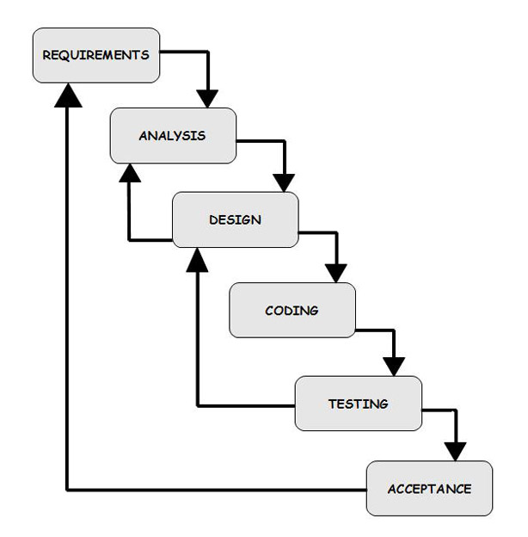
Waterfall Model

Slide 4
Disadvantages of Waterfall Model
It is difficult to estimate time and cost for each phase of the development process.
Once an application is in the testing stage, it is very difficult to go back and change something that was not well-thought out in the concept stage.
Not a good model for complex and object-oriented projects.
Not suitable for the projects where requirements are at a moderate to high risk of changing.

Slide 5
Agile Model
Agile development model is also a type of Incremental model. Software is developed in incremental, rapid cycles. This results in small incremental releases with each release building on previous functionality. Each release is thoroughly tested to ensure software quality is maintained.
Agile software development method emphasis on iterative, incremental, and evolutionary development.

Slide 6

Agile Model

Slide 7
Delay
In spite of the Model, still delay?
Gap between development team and operations team

Slide 8
Operations Team responsibilities
Installation of server hardware and OS
Configuration of servers, networks, storage, etc…
Monitoring of servers
Respond to outages
IT security
Change control
Backup and disaster recovery planning
Production Support

Slide 9
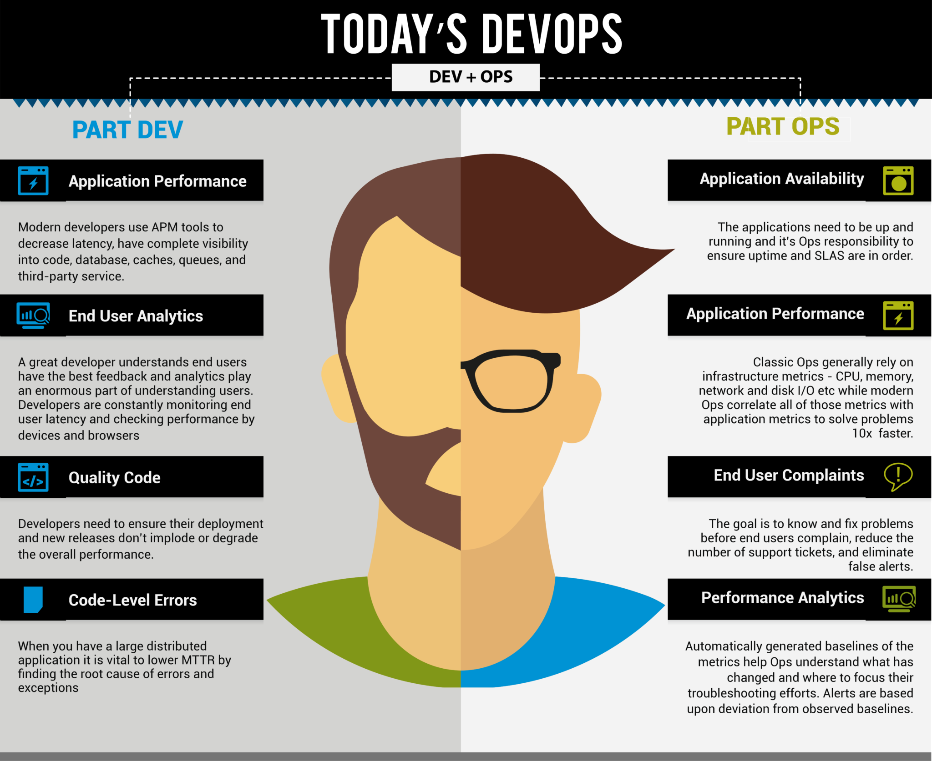
Reasons for Delay

Slide 10
Devops and its importance
DevOps is a methodology that promotes collaboration between Development and Operations Team. This allows deploying code to production faster and in an automated way. It helps to enables rapid deployment of products.

Slide 11
Course Content
Linux
Git
Maven
Jenkins
Docker and Docker Swarm
Kubernetes
Ansible
Nagios
Terraform
Timings 06:00 AM to 07:00 AM IST Monday to Friday

Slide 12

Q&A
Email: support@logiclabstech.com

Slide 13


